Slide 1

Chemical Equilibrium
SAVE PAPER AND INK!!! When you print out the notes on PowerPoint, print "Handouts" instead of "Slides" in the print setup. Also, turn off the backgrounds (Tools>Options>Print>UNcheck "Background Printing")!
Chapter 17 (Honors)
Notes:
1
1
1
1

Slide 2
Equilibrium
We’ve already used the phrase “equilibrium” when talking about reactions.
In principle, every chemical reaction is reversible ... capable of moving in the forward or backward direction.
2 H₂ + O₂ 2 H₂O
Some reactions are easily reversible ...
Some not so easy ...

Slide 3
Equilibrium: the extent of a reaction
In stoichiometry we talk about theoretical yields, and the many reasons actual yields may be lower.
Another critical reason actual yields may be lower is the reversibility of chemical reactions: some reactions may produce only 70% of the product you may calculate they ought to produce.
Equilibrium looks at the extent of a chemical reaction.

Slide 4
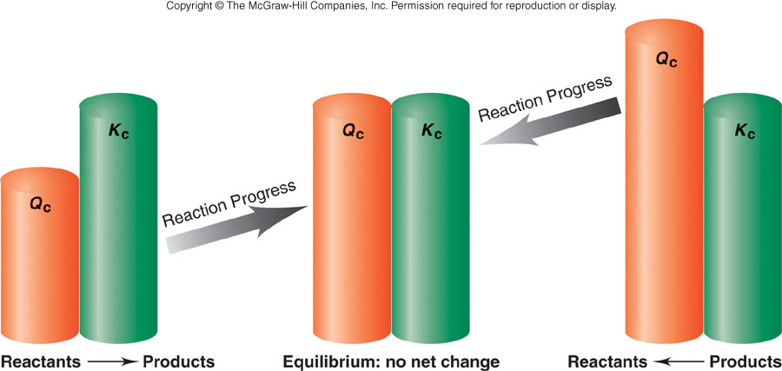
If Q < K_{eq}, shift to
right (toward product)
If Q > K_{eq}, shift to
left (toward reactant)

Slide 5
The Concept of Equilibrium
Consider colorless frozen N₂O₄. At room temperature, it decomposes to brown NO₂:
N₂O₄(g) → 2NO₂(g).
At some time, the color stops changing and we have a mixture of N₂O₄ and NO₂.
Chemical equilibrium is the point at which the rate of the forward reaction is equal to the rate of the reverse reaction. At that point, the concentrations of all species are constant.
Using the collision model:
as the amount of NO₂ builds up, there is a chance that two NO₂ molecules will collide to form N₂O₄.
At the beginning of the reaction, there is no NO₂ so the reverse reaction (2NO₂(g) → N₂O₄(g)) does not occur.

Slide 6
The Concept of Equilibrium
As the substance warms it begins to decompose:
N₂O₄(g) → 2NO₂(g)
When enough NO₂ is formed, it can react to form N₂O₄:
2NO₂(g) → N₂O₄(g).
At equilibrium, as much N₂O₄ reacts to form NO₂ as NO₂ reacts to re-form N₂O₄
The double arrow implies the process is dynamic.

Slide 7
The Concept of Equilibrium
As the reaction progresses
[A] decreases to a constant,
[B] increases from zero to a constant.
When [A] and [B] are constant, equilibrium is achieved.

Slide 8
The Equilibrium Constant
No matter the starting composition of reactants and products, the same ratio of concentrations is achieved at equilibrium.
For a general reaction
the equilibrium constant expression is
where K_{c} is the equilibrium constant.

Slide 9
The Equilibrium Constant
K_{c} is based on the molarities of reactants and products at equilibrium.
We generally omit the units of the equilibrium constant.
Note that the equilibrium constant expression has products over reactants.

Slide 10
The Equilibrium Expression
Write the equilibrium expression for the following reaction:

Slide 11
The Equilibrium Constant
The Equilibrium Constant in Terms of Pressure
If K_{P} is the equilibrium constant for reactions involving gases, we can write:
K_{P} is based on partial pressures measured in atmospheres.

Slide 12
The Equilibrium Constant
The Magnitude of Equilibrium Constants
The equilibrium constant, K, is the ratio of products to reactants.
Therefore, the larger K the more products are present at equilibrium.
Conversely, the smaller K the more reactants are present at equilibrium.
If K >> 1, then products dominate at equilibrium and equilibrium lies to the right.
If K << 1, then reactants dominate at equilibrium and the equilibrium lies to the left.

Slide 13
The Equilibrium Constant
The Magnitude of Equilibrium Constants
An equilibrium can be approached from any direction.
Example:

Slide 14
The Equilibrium Constant
The Magnitude of Equilibrium Constants
However,
The equilibrium constant for a reaction in one direction is the reciprocal of the equilibrium constant of the reaction in the opposite direction.

Slide 15
The Equilibrium Constant
Heterogeneous Equilibria
When all reactants and products are in one phase, the equilibrium is homogeneous.
If one or more reactants or products are in a different phase, the equilibrium is heterogeneous.
Consider:
experimentally, the amount of CO₂ does not seem to depend on the amounts of CaO and CaCO₃. Why?

Slide 16
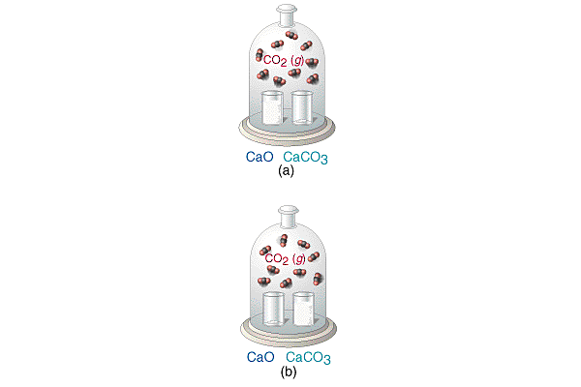
The Equilibrium Constant
Heterogeneous Equilibria

Slide 17
The Equilibrium Constant
Heterogeneous Equilibria
Neither density nor molar mass is a variable, the concentrations of solids and pure liquids are constant. (You can’t find the concentration of something that isn’t a solution!)
We ignore the concentrations of pure liquids and pure solids in equilibrium constant expressions.
The amount of CO₂ formed will not depend greatly on the amounts of CaO and CaCO₃ present.
K_{c} = [CO₂]

Slide 18
Calculating Equilibrium Constants
Steps to Solving Problems:
Write an equilibrium expression for the balanced reaction.
Write an ICE table. Fill in the given amounts.
Use stoichiometry (mole ratios) on the change in concentration line.
Deduce the equilibrium concentrations of all species.
Usually, the initial concentration of products is zero. (This is not always the case.)

Slide 19
Applications of Equilibrium Constants
Predicting the Direction of Reaction
We define Q, the reaction quotient, for a reaction at conditions NOT at equilibrium
as
where [A], [B], [P], and [Q] are molarities at any time.
Q = K only at equilibrium.

Slide 20
Applications of Equilibrium Constants
Predicting the Direction of Reaction
If Q > K then the reverse reaction must occur to reach equilibrium (go left)
If Q < K then the forward reaction must occur to reach equilibrium (go right)

Slide 21

Example Problem: Calculate Concentration
Note the moles into a 10.32 L vessel stuff ... calculate molarity.
Starting concentration of HI: 2.5 mol/10.32 L = 0.242 M
2 HI H₂ + I₂
Initial:
Change:
Equil:
0.242 M 0 0
-2x +x +x
0.242-2x x x
What we are asked for here is the equilibrium concentration of H₂ ...
... otherwise known as x. So, we need to solve this beast for x.

Slide 22
Example Problem: Calculate Concentration
And yes, it’s a quadratic equation. Doing a bit of rearranging:
x = 0.00802 or –0.00925
Since we are using this to
model a real, physical system,
we reject the negative root.
The [H₂] at equil. is 0.00802 M.

Slide 23

Example Problem: Calculate Keq
This type of problem is typically tackled using the “three line” approach:
2 NO + O₂ 2 NO₂
Initial:
Change:
Equilibrium:

Slide 24
Approximating
If Keq is really small the reaction will not proceed to the right very far, meaning the equilibrium concentrations will be nearly the same as the initial concentrations of your reactants.
0.20 – x is just about 0.20 is x is really dinky.
If the difference between Keq and initial concentrations is around 3 orders of magnitude or more, go for it. Otherwise, you have to use the quadratic.

Slide 25
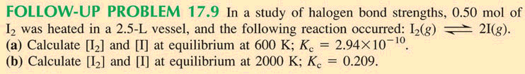
Example
Initial Concentration of I₂: 0.50 mol/2.5L = 0.20 M
I₂ 2 I
More than 3
orders of mag.
between these
numbers. The
simplification will
work here.
Initial
change
equil:
0.20 0
-x +2x
0.20-x 2x
With an equilibrium constant that small, whatever x is, it’s near
dink, and 0.20 minus dink is 0.20 (like a million dollars minus a
nickel is still a million dollars).
0.20 – x is the same as 0.20
x = 3.83 x 10⁻⁶ M

Slide 26
Example
Initial Concentration of I₂: 0.50 mol/2.5L = 0.20 M
I₂ 2 I
Initial
change
equil:
0.20 0
-x +2x
0.20-x 2x
These are too close to
each other ...
0.20-x will not be
trivially close to 0.20
here.
Looks like this one has to proceed through the quadratic ...

Slide 27
Le Châtelier’s Principle
Le Chatelier’s Principle: if you disturb an equilibrium, it will shift to undo the disturbance.
Remember, in a system at equilibrium, come what may, the concentrations will always arrange themselves to multiply and divide in the Keq equation to give the same number (at constant temperature).

Slide 28
Le Châtelier’s Principle
Change in Reactant or Product Concentrations
Adding a reactant or product shifts the equilibrium away from the increase.
Removing a reactant or product shifts the equilibrium towards the decrease.
To optimize the amount of product at equilibrium, we need to flood the reaction vessel with reactant and continuously remove product (Le Châtelier).
We illustrate the concept with the industrial preparation of ammonia

Slide 29
Le Châtelier’s Principle
Change in Reactant or Product Concentrations
Consider the Haber process
If H₂ is added while the system is at equilibrium, the system must respond to counteract the added H₂ (by Le Châtelier).
That is, the system must consume the H₂ and produce products until a new equilibrium is established.
Therefore, [H₂] and [N₂] will decrease and [NH₃] increases.

Slide 30
Le Châtelier’s Principle
Change in Reactant or Product Concentrations
The unreacted nitrogen and hydrogen are recycled with the new N₂ and H₂ feed gas.
The equilibrium amount of ammonia is optimized because the product (NH₃) is continually removed and the reactants (N₂ and H₂) are continually being added.
Effects of Volume and Pressure
As volume is decreased pressure increases.
Le Châtelier’s Principle: if pressure is increased the system will shift to counteract the increase.

Slide 31
Le Châtelier’s Principle
Consider the production of ammonia
As the pressure increases, the amount of ammonia present at equilibrium increases.
As the temperature decreases, the amount of ammonia at equilibrium increases.
Le Châtelier’s Principle: if a system at equilibrium is disturbed, the system will move in such a way as to counteract the disturbance.

Slide 32
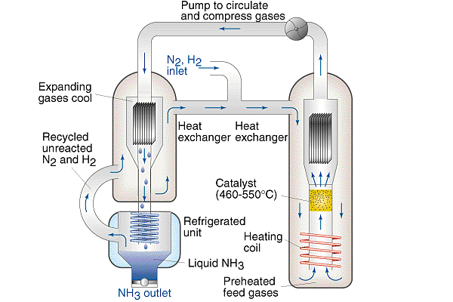
Le Châtelier’s Principle
Change in Reactant or Product Concentrations

Slide 33
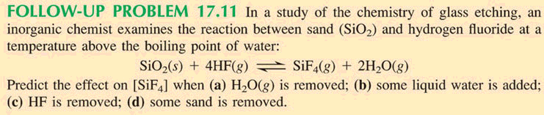
Example

Slide 34
Le Châtelier’s Principle
Effects of Volume and Pressure
The system shifts to remove gases and decrease pressure.
An increase in pressure favors the direction that has fewer moles of gas.
In a reaction with the same number of product and reactant moles of gas, pressure has no effect.
Consider

Slide 35
Le Châtelier’s Principle
Effects of Volume and Pressure
An increase in pressure (by decreasing the volume) favors the formation of colorless N₂O₄.
The instant the pressure increases, the system is not at equilibrium and the concentration of both gases has increased.
The system moves to reduce the number moles of gas (i.e. the forward reaction is favored).
A new equilibrium is established in which the mixture is lighter because colorless N₂O₄ is favored.

Slide 36
Le Châtelier’s Principle
Effect of Temperature Changes
The equilibrium constant is temperature dependent.
For an endothermic reaction, ΔH > 0 and heat can be considered as a reactant.
For an exothermic reaction, ΔH < 0 and heat can be considered as a product.
Adding heat (i.e. heating the vessel) favors away from the increase:
if ΔH > 0, adding heat favors the forward reaction,
if ΔH < 0, adding heat favors the reverse reaction.

Slide 37
Le Châtelier’s Principle
Effect of Temperature Changes
Removing heat (i.e. cooling the vessel), favors towards the decrease:
if ΔH > 0, cooling favors the reverse reaction,
if ΔH < 0, cooling favors the forward reaction.
Consider
for which ΔH > 0.
Co(H₂O)₆²⁺ is pale pink and CoCl₄²⁻ is blue.

Slide 38
Solubility Product Principle
Another equilibrium situation is slightly soluble products
K_{sp} is the solubility product constant
K_{sp} can be found on a chart at a specific temperature
Since the product is solid on the left side, only the products (ions) are involved in the K_{sp} expression

Slide 39
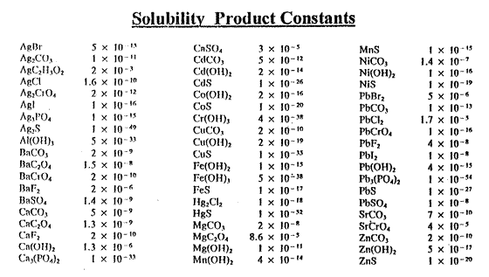
Solubility Product Principle

Slide 40
Solubility Product Principle
Example: Find the concentration of ions present in calcium fluoride (in water) and the molar solubility.
CaF₂(s) --> Ca⁺² + 2 F⁻
K_{sp} = [Ca⁺²] [F⁻]² = 2 X 10 ⁻¹⁰
If x = [Ca⁺² ], then [F⁻] = 2x
[x] [2x]² = 2 X 10 ⁻¹⁰
4x³ = 2 X 10 ⁻¹⁰
x³ = 5 X 10 ⁻¹¹
x = 3.68 X 10 ⁻⁴
[Ca⁺² ] = x = 3.68 X 10 ⁻⁴ [F⁻] = 2x = 7.37 X 10 ⁻⁴
Solubility of CaF₂ = 3.68 X 10 ⁻⁴

Slide 41
Solubility Product Principle
Example: Find the molar solubility of silver chloride (in water).
AgCl (s) --> Ag⁺ + Cl ⁻

